Slide 1
XA/XD LTSR version overview
Overview of Long Term Service Release (LTSR)
Kevin Cui
Lead Sales Engineer

Slide 2
Index
LTSR版本介绍
升级建议
客户案例

Slide 3


Citrix XA/XD产品版本
Long Term
Service Release
(LTSR)
7.6 LTSR
Current Release
(CR)
5.X
7.X

Slide 4


LTSR版本特点
扩展的生命周期
可预知的维护
减少IT支出
$
$
$
$
5 years mainstream support &
5 years extended support
Scheduled cumulative updates with fixes only
Simplified on-going management and maintenance reduces IT cost

Slide 5
第一个LTSR版本
Citrix Summit – Las Vegas
Q4’15 |  |  | Q1’16 |  |  | 2016 |  |  | 2017 | 2018
Oct | Nov | Dec | Jan | Feb | March | Q2 | Q3 | Q4
Product Version | End of Life Dates | End of Extended Support Dates
XA/XD 7.x (Any Version) | 30-Jun-18 | 10-Jan-23 (2012R2) 14-Jan-20 (2008R2)
XA/XD 7.6 (LTSR versions) | 11- Jan-21 | 11-Jan-26 (2012R2 Only)
XenApp & XenDesktop
7.6 LTSR
(Jan 11th, 2016)

Slide 6
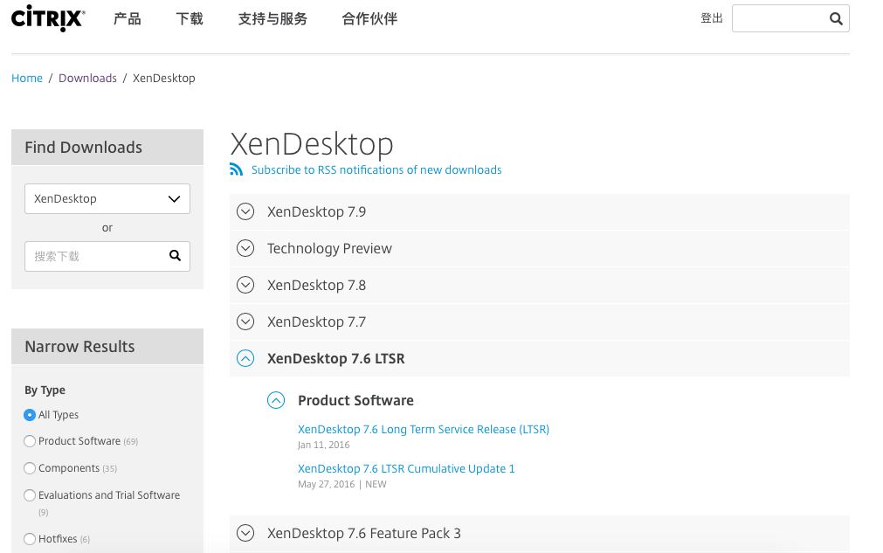
第一个LTSR版本

Slide 7
Citrix产品版本对比
 | Long Term Service Release (LTSR) | Current Release (CR)
Software Maintenance Required | Yes¹ | Optional²
Product Lifecycle Timelines | 5 years of mainstream support + 5 years of extended support³ | Standard product lifecycle milestones⁴
Access to Releases | Citrix.com/Downloads | Citrix.com/Downloads
Cumulative Updates | Yes⁵ | No⁶
Includes Fixes | Yes⁷ | Yes⁸
Cumulative Update Schedule | 4-6 months⁹ | N/A
Release Schedule | 12-24 months⁹ | 3-9 months⁹
Enhancement Requests | No enhancements until next LTSR | Rapid release cycles, more opportunities for enhancements
1.Software Maintenance Program information
2.Subscription Advantage or Software Maintenance is required and standard terms apply. Separate support contract is required with Subscription Advantage.
3.Separate support contract is required for extended support
4.Standard product lifecycle milestones information
5.Cumulative Updates will typically contain only fixes for Long Term Service Release sites. You will be asked to install relevant Cumulative Updates on Long Term Service Release sites.
6.Rapid release cycles allow you to add new features and all public fixes by upgrading to the next Current Release. You will be asked to upgrade Current Release sites to a newer release that includes relevant fixes as well as new features and functionality.
7.Customers on Long Term Service Releases will be asked to update to next Cumulative Update that contains the fix.
8.Customers on Current Releases might be asked to upgrade to next release that contains the fix.
9.General guidance, Citrix does not make product roadmaps public.

Slide 8
举例：XenApp LTSR版本生命周期 -- Citrix产品生命周期定义
Notice of Status Change (NSC)
Notice of Status Change (NSC) is the date on which Citrix publicly communicates the specific dates for a product's End of Sales (EOS), End of Maintenance (EOM), and End of Life (EOL). This information is posted within the Product Matrix Table or Legacy Product Matrix Table.
End of Sales (EOS)
The date that signifies when a specific software or appliance release will no longer be available for purchase.
End of Maintenance (EOM)
The date that signifies when a specific product release will have no further code-level maintenance other than security-related updates.
End of Life (EOL)
The date that signifies when security related hot fixes, technical support and product downloads will no longer be available.
Notes:
https://www.citrix.com/support/product-lifecycle/milestones.html
General Availability (GA)
The date that signifies when a new product release may be ordered and fulfilled in all applicable languages, discount programs, delivery methods, and worldwide geographies.

Slide 9
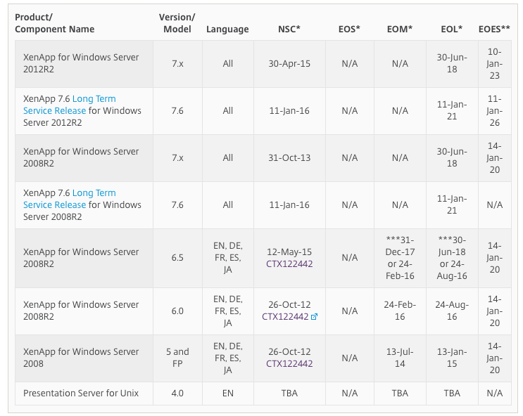
举例：XenApp LTSR版本生命周期
Notes:
https://www.citrix.com/support/product-lifecycle/product-matrix.html

Slide 10
LTSR版本总结
1.每1~2年选定一个较为稳定的版本标定为LTSR版本，从此版本发布之日起将可以提供5年技术支持服务，5年延长技术支持服务。即最长可提供10年服务。
2.第一个LTSR版本是基于XenApp/XenDesktop 7.6 FP3为蓝本来构建的。
3. LTSR版本将选择并固化包括XD/PVS/SF等核心组件以及支持的操作系统的版本，按计划推出cumulative update，以保证产品的稳定性以及所支持的功能完善。
4.LTSR版本将不会提供在此版本之后发布任何新版本中的新功能，除非你选择下一个版本的LTSR版本。

Slide 11
Index
LTSR版本介绍
版本升级建议
客户案例

Slide 12
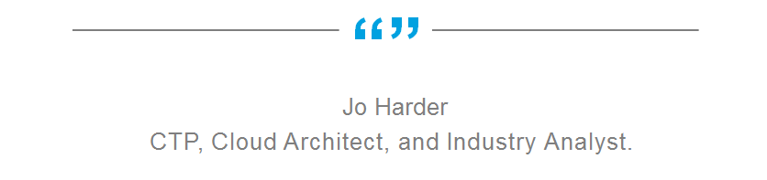
“As much as large enterprises would like to rapidly add new features to
XenApp/XenDesktop implementations, often times, that’s just not
feasible. Long Term Service Release is particularly beneficial to large
enterprises that are focused on stability. By providing patches, hotfixes, and service packs that are sans new features, stability is preserved and change control impact is minimized. As needed, projects focused on upgrading and adding features can be undertaken with appropriate planning.”
Jo Harder
CTP, Cloud Architect, and Industry Analyst.

Slide 13
升级策略
1
EOL
EOL
EOL
12-24 months between LTSRs
Next LTSR
1
EOL
新功能
New Current Release
New Current Release
XenApp/XenDesktop (7.8)
升级
XenApp/XenDesktop (7.7)
XenApp/XenDesktop 7.6 Long Term Service Release
LTSR
1
EOL
Cumulative Update 1
CU2
CU3
CU4
…
CR
时间

Slide 14
LTSR 版本升级考虑点
同时拥有
  You can have a Long Term Service Release site and Current Release site running side-by-side.
随时切换
  You can choose to keep a site on a Long Term Service Release for an extended period of time, you can choose to move a LTSR site to a Current Release at any time.
不包括所有XD/XA组件
  Not all XenApp and XenDesktop components will have a Long Term Service Release (e.g Personal vDisk, Receivers); however, Citrix may add additional components to a particular LTSR release post launch.
不包括所有XD/XA功能
  Frame hawk
  Local App Access
维保是前提
  XenApp (Adv, Ent, Plat) and XenDesktop (VDI, Ent, Plat) editions have access to Long Term Service Releases, however Software Maintenance is required to receive the full benefits.

Slide 15
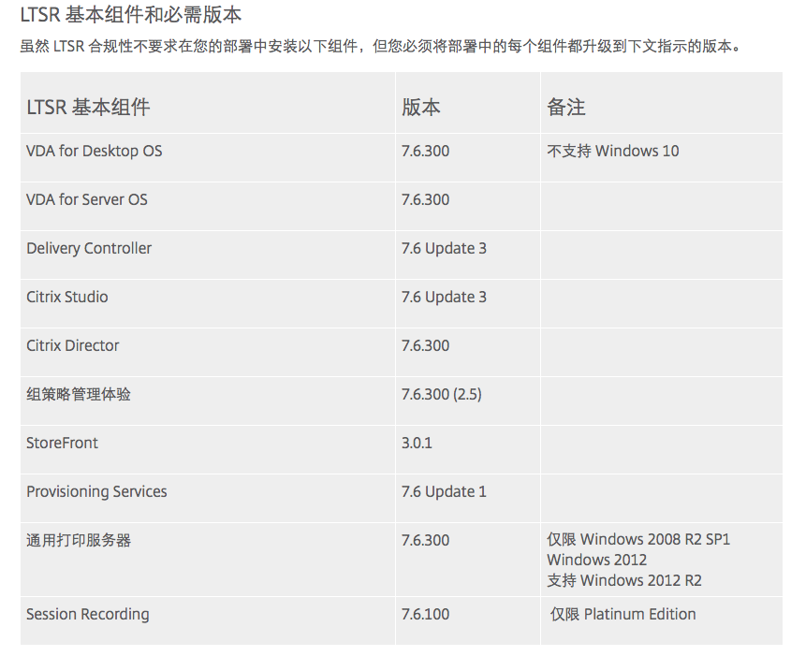
LTSR组件和必须版本
多个组件的 LTSR 版本已经发布了一段时间，主要作为 Feature Pack 3 的一部分提供。 这意味着，如果您已将部署升级到 Feature Pack 3，多个组件已符合 LTSR。 在这些情况下，您不需要进一步执行任何操作。

Slide 16
7.6 LTSR 兼容组件
What is a Compatible Component?
Recommended for 7.6 LTSR sites
Not eligible for LTSR benefits
  No Extended Lifecycle
  No Cumulative Updates
Citrix may ask you to upgrade this component to a newer version
7.6 LTSR Compatible Components:
Profile Manager (UPM) 5.4
AppDNA 7.6.5
License Server 11.13.1*
RealTime Optimization Pack 2.0
Receivers:
  Special Program for Windows Receiver > New LTSR version of Receiver every ~18 months
Citrix Receiver | Recommended version | Release date
Citrix Receiver for Windows | 4.4 or later | December 20, 2015
Citrix Receiver for Linux | 13.2.1 or later | August 24, 2015
Citrix Receiver for Mac | 12.1 or later | October 27,2015
Citrix Receiver for Chrome | 1.8 or later | September 28, 2015
Citrix Receiver for HTML5 | 1.8 or later | September 28, 2015
Citrix Receiver for iOS | 6.1.1 or later | October 16, 2015
Citrix Receiver for Android | 3.8 or later | October 30, 2015

Slide 17
7.6 LTSR Notable Exclusions
What is a Notable Exclusion?
Components that are not ideal for LTSR
Not eligible for LTSR benefits
  No Extended Lifecycle
  No Cumulative Updates
If you have an excluded component, you maybe asked to remove it to make your site LTSR compliant and eligible for the extended lifecycle milestones.
7.6 LTSR Notable Exclusions:
Features
  Local App Access
  Framehawk
Platforms
  Windows 10
  Windows 2008 32 bit (For Universal Print Server)
Components
  Linux VDA
  Personal vDisk (PVD)

Slide 18
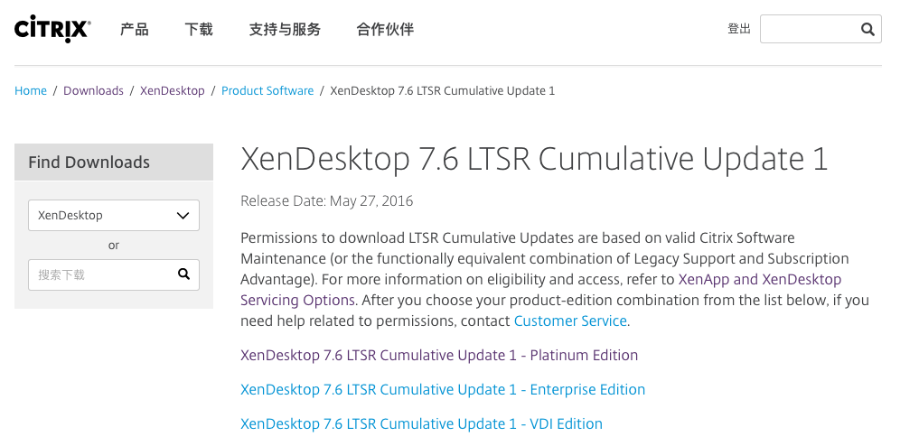
Cumulative Update
Cumulative updates contain only fixes
Released at a regular cadence for predictable maintenance
Single package that contains all fixes that can be downloaded from Citrix.com for Software Maintenance customers.

Slide 19
Index
LTSR版本介绍
升级建议
客户案例

Slide 20
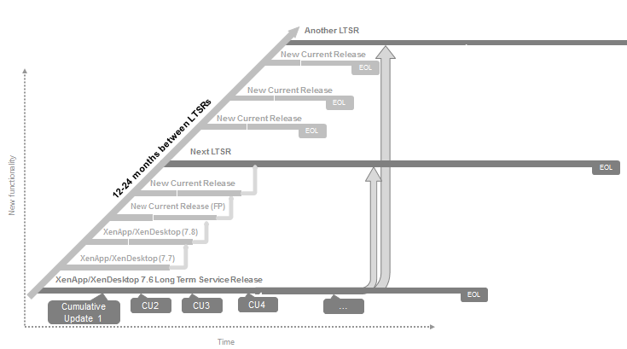

Customer Examples
1
Customer A
1
1
1
1
1
1
EOL

Slide 21
Customer Examples
Customer B

Slide 22
Customer Examples
Customer C

Slide 23





Similar Industry Programs
Long Term Servicing Branch
Extended Support Release
Extended Support Release
Long Lifecycle Versions
Long Term Service Pack

Slide 24
资源
Citrix.com Servicing Options website:
  Citrix.com/Support/LTSR
Servicing Options datasheet:
  www.citrix.com/content/dam/citrix/en_us/documents/products-solutions/citrix-xenapp-xendesktop-servicing-options-datasheet.pdf
Servicing Options FAQ
  Customer facing version http://support.citrix.com/article/CTX205549
7.6 LTSR Product Documentation
  http://docs.citrix.com/en-us/xenapp-and-xendesktop/7-6/xad-whats-new/long-term-service-release.htm

