Slide 1

NetScaler Unified Gateway
ChengXi
Delivery Networks
Notes:
Hello everyone. Thanks for joining us and showing interest in our awesome product, NetScaler Unified Gateway. I am Akhilesh Dhawan, product marketing for NetScaler and I am joined by my colleague, Manohar Singareddy, who is the product manager.

Slide 2

NS Gateway ： 通常仅想到 XenApp 和 XenDesktop的用例
SaaS
SG
ADC
ICA
SSL VPN
mVPN
Mobile User
Client/Server
Public Cloud
Hybrid Cloud
On Prem
Distributed App Infrastructure
Notes:
From an Enterprise datacenter point of view, this is how it looks like. There have been too many specialized solutions that focus on very limited use cases. There is traditional SSL VPN solutions for remotely accessing client server or Enterprise applications, there are ADCs for load balancing and improving security of web applications, we have cloud gateway functionality in datacenters to monitor and control access to Cloud and SaaS applications, we have specialized mobile VPN appliances because traditional SSL VPN solutions do not cater to mobile apps and mobile devices and then we have proxy solutions for VDI applications we all know very well like ICA proxy for XA/XD. Now these are too many remote access solutions customers are running in their datacenters.
To make it a little more challenging, some of these applications have moved from on-prem datacenters to a public or hybrid cloud and IT seems to have lost some control over access control and security of these applications.
Lets first talk about too many point solutions. What happens, when we have too many point solutions? There is chaos.
For users: They have multiple URLs to access applications remotely, different portals and different UI etc., have to deal with installing multiple plugins on their devices.
Management of these many devices mean, you need more skill sets, more trainings, working with multiple vendors, planning for multiple upgrades. It just results in a management nightmare, and also increases cost to maintain all these devices.
So how can we solve this for everyone involved?

Slide 3
但仍留下很多问题需要解决
SaaS
多种解决方案导致了:
  多个URLs 导致用户体验非常差
  复杂的架构难以管理
  各自为政，很难集成
  不同的系统多种升级周期导致使用中断
  安全策略访问策略不能统一，且难发现误配置
SG
NetScaler with Unified Gateway 提供 One URL 解决方案
ADC
ICA
SSL VPN
mVPN
Mobile User
Client/Server
Public Cloud
Hybrid Cloud
On Prem
Distributed App Infrastructure
Notes:
From an Enterprise datacenter point of view, this is how it looks like. There have been too many specialized solutions that focus on very limited use cases. There is traditional SSL VPN solutions for remotely accessing client server or Enterprise applications, there are ADCs for load balancing and improving security of web applications, we have cloud gateway functionality in datacenters to monitor and control access to Cloud and SaaS applications, we have specialized mobile VPN appliances because traditional SSL VPN solutions do not cater to mobile apps and mobile devices and then we have proxy solutions for VDI applications we all know very well like ICA proxy for XA/XD. Now these are too many remote access solutions customers are running in their datacenters.
To make it a little more challenging, some of these applications have moved from on-prem datacenters to a public or hybrid cloud and IT seems to have lost some control over access control and security of these applications.
Lets first talk about too many point solutions. What happens, when we have too many point solutions? There is chaos.
For users: They have multiple URLs to access applications remotely, different portals and different UI etc., have to deal with installing multiple plugins on their devices.
Management of these many devices mean, you need more skill sets, more trainings, working with multiple vendors, planning for multiple upgrades. It just results in a management nightmare, and also increases cost to maintain all these devices.
So how can we solve this for everyone involved?

Slide 4


NetScaler Unified Gateway ：一个URL 访问任何应用
ONE URL
Notes:
As I mentioned earlier NetScaler Gateway provides one single access point for any type of application. Be it a web or an legacy enterprise application like SharePoint or RDP proxy, Citrix apps like XenApp and XenDesktop, cloud or SaaS apps like ShareFile, SFDC or Go to Meeting or apps on mobile devices.

Slide 5
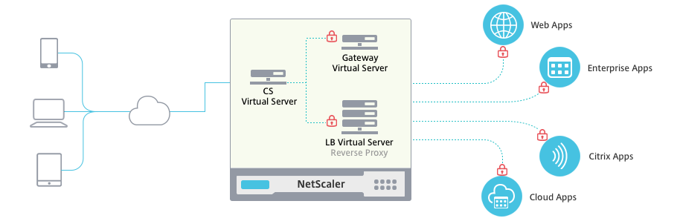
Sample Unified Gateway Architecture

Slide 6

UG登录界面

Slide 7
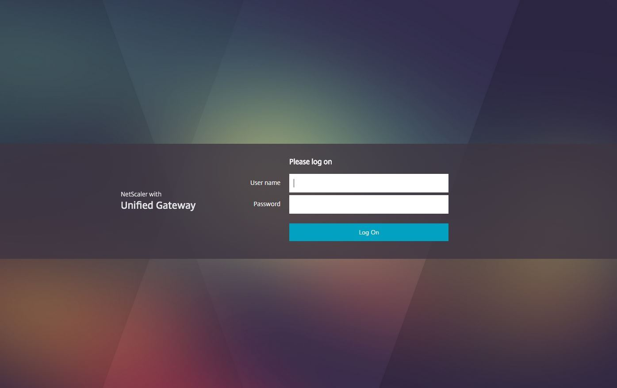

Slide 8
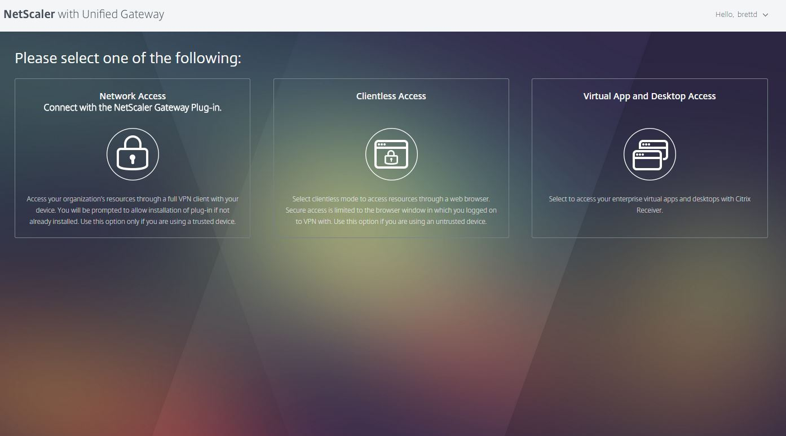

Slide 9
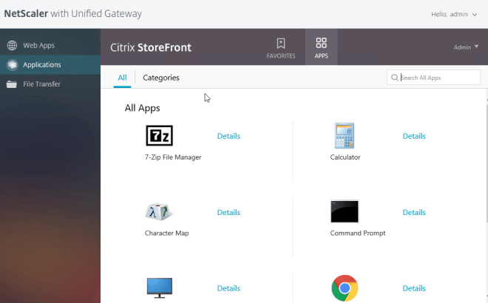

Slide 10
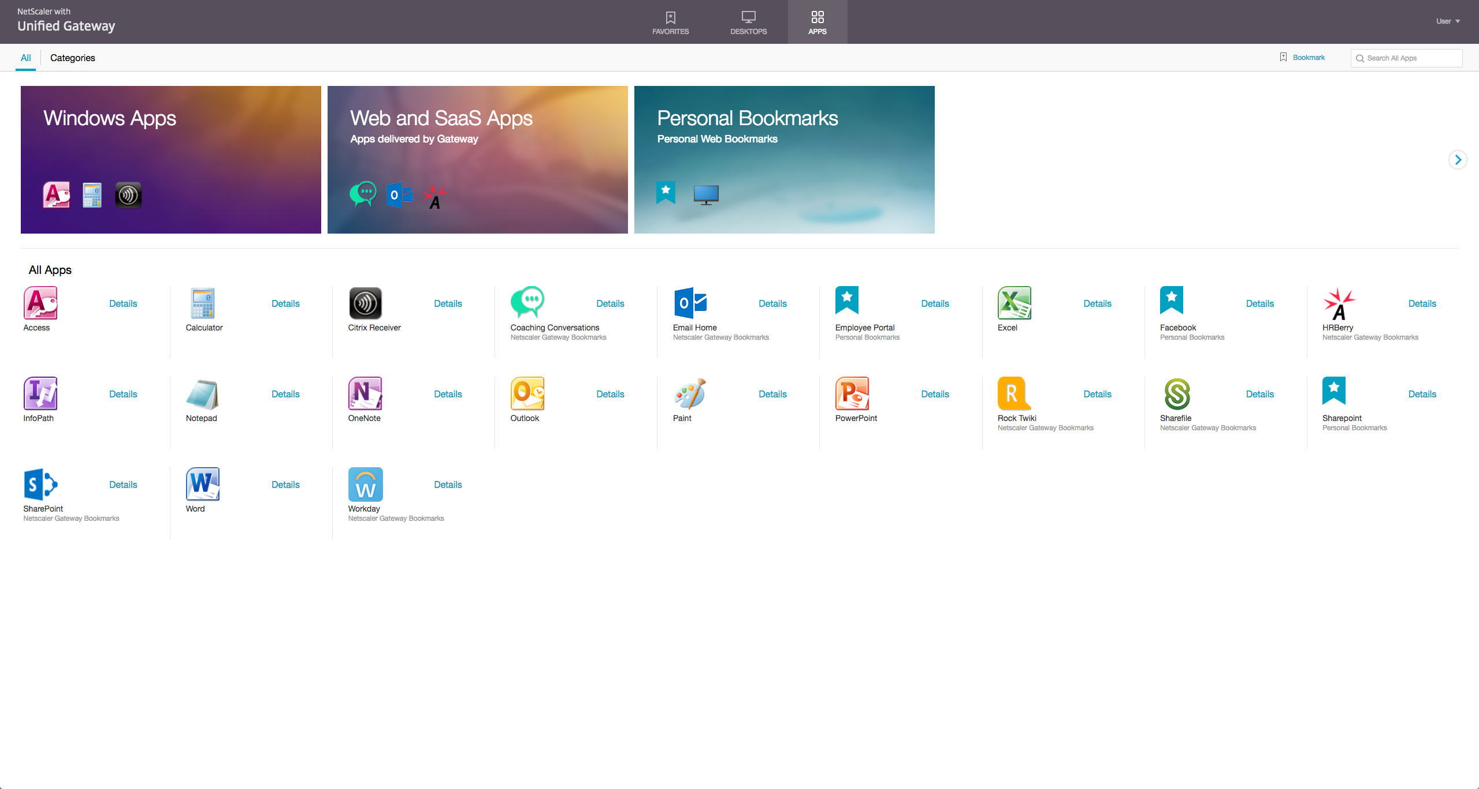

Slide 11
UG新技术介绍

Slide 12
NetScaler Unified Gateway 全新特性
体验
安全
整合
Linux, Android 和 iOS的VPN客户端
高度定制的页面
所有应用单点登录
Full SSL VPN 隧道和基于应用的 VPN隧道（iOS）
SmartControl 集中管理
One URL 技术提供整合
内容交换允许单URL访问所有应用
任何设备任何地点均可以访问
Threats
Video
Network
Visibility
+ Control
Access
SLAs
ICA Proxy
SSL VPN
SaaS
Gateway
QoS
Optimized
Future-proof architecture
Granular and Dynamic security policies
One click access to all apps
Notes:
So what is new in this release of NetScaler.
The new release and features ties in closely with our company objectives (Experience, Security and Flexibility).
Experience
We have improved on our SSL VPN features and covered the gaps we had in the past. We have included content switching in our gateway product that allows us to provide one URL for all applications sitting behind NetScaler.
Including new features such as the new customizable portal will provide a much better user experience for our customers. Customers can fully brand their portals the way they choose, including background images, authentication fields, EULA agreements, logo etc. One can have also have multiple branding themes.
In the previous release we did not have the ability to provide single signon between XA/XD and AAATM applications. With this release we now have the ability. This is a big use case for our current and new XA/XD customers.
The new release also provides auto-reconnect in case a user is moving between networks.
Security
NetScaler now provides both full SSL VPN tunnel and per app VPN tunnel for Android and iOS devices. Using this, customers can use these platforms to securely access business applications from their smartphones
NetScaler now allows centralized management of XA/XD policies and improves security at the datacenter edge.
Support Mobility
Finally, for customers who view mobility strategically, Citrix addresses the app gap by providing users access to all their all their apps - including legacy and Windows desktop apps…not just mobile apps through the integration of XenDesktop and XenApp. In addition, Citrix allows companies to mobilize business processes through our mobile app platform and partnerships with mBaaS and MEAP providers.

Slide 13
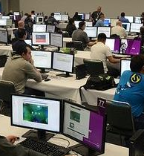
VPN客户端

Slide 14
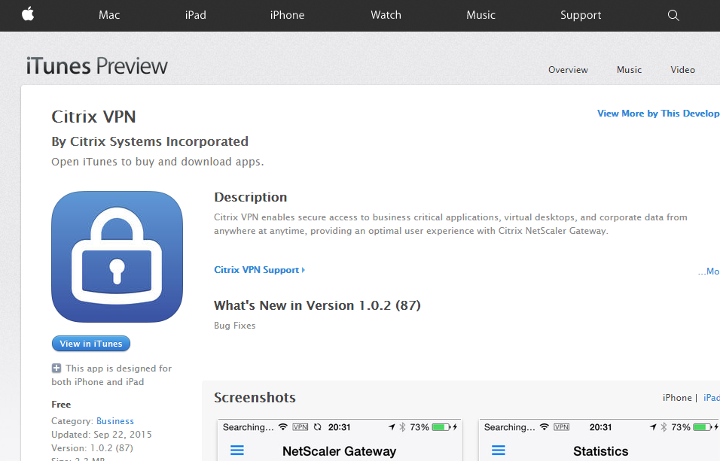
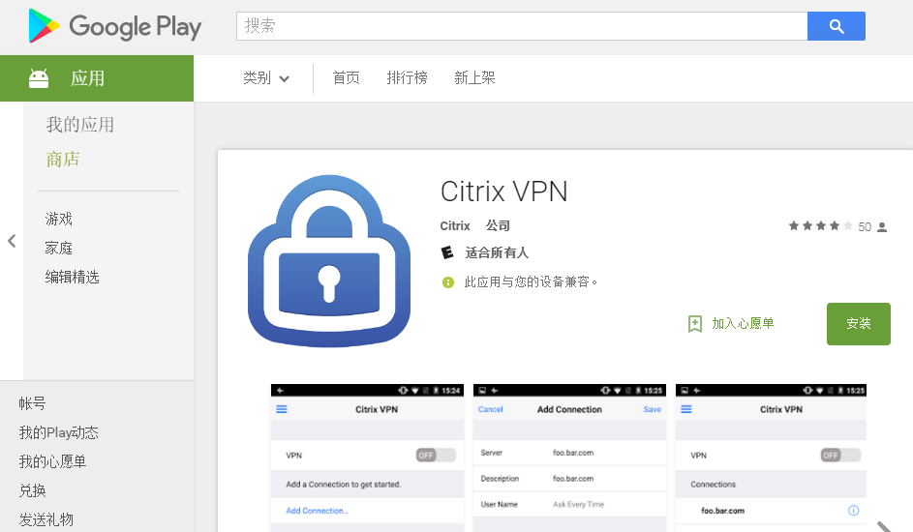
NetScaler Unified Gateway 客户端：ios android Linux Mac Win

Slide 15
RDP代理

Slide 16
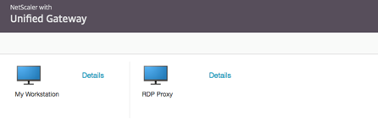
RDP proxy：类似ICA proxy

Slide 17
自定义页面

Slide 18
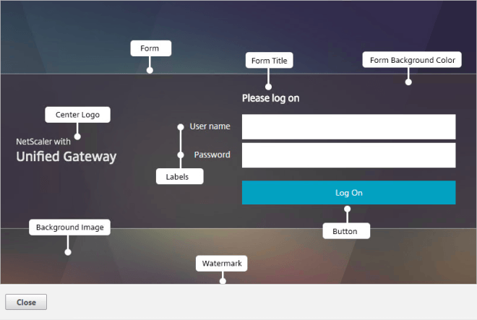
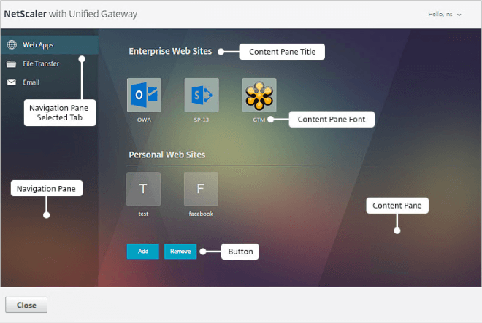
NetScaler Unified Gateway 自定义页面

Slide 19
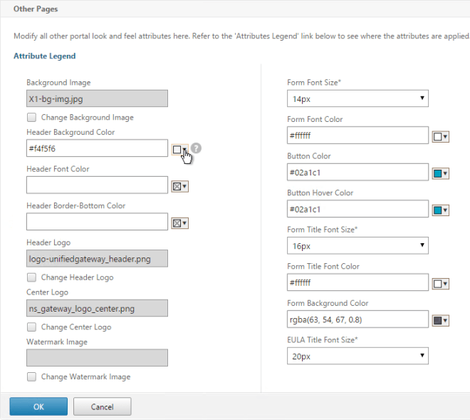
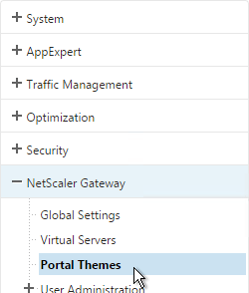

Slide 20
Smartcontrol

Slide 21
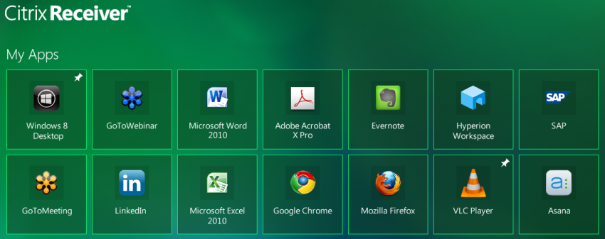

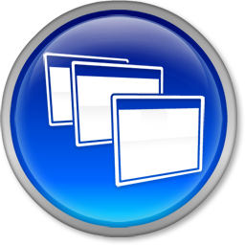
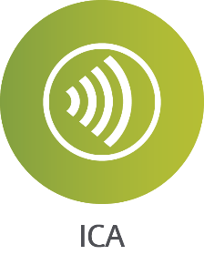
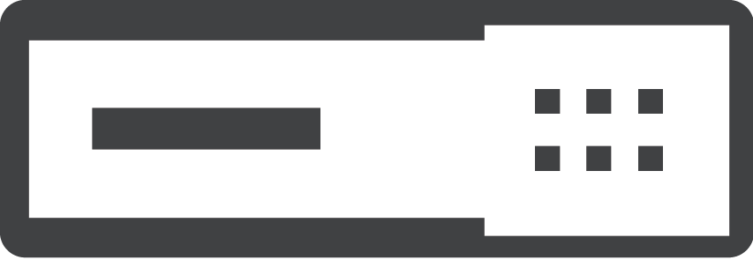
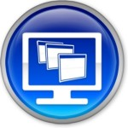
SmartControl
Intranet
Compliant
ICA Traffic
Full Access
Storefront farm
DMZ Fw
Limited:
DC Fw
Storefront farm
NetScaler with Unified Gateway
Copy/Paste
Drive Access
Print Access
Storefront farm
Citrix Virtualization solution
Storefront farm

Slide 22
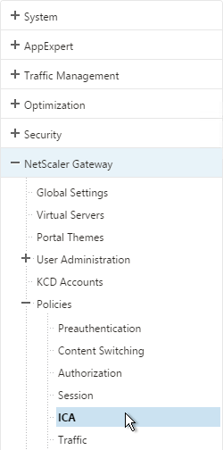
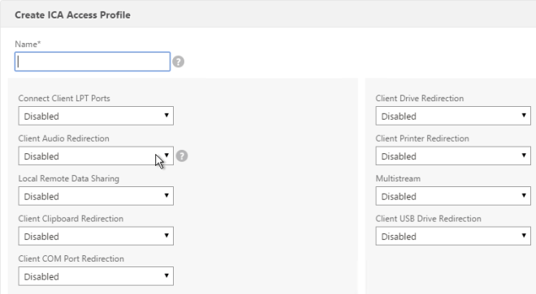

Slide 23
多因素认证

Slide 24
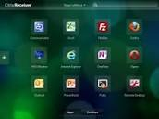

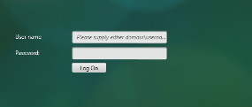
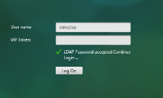
传统模型
所有用户使用同样认证流程，不同的需要再建不同的入口
最多双因素认证
认证因子没有适应能力 - 不能从初始识别用户组
一些认证因子只能作为 primary认证
Sam
Bob

Slide 25
nfactor
Gateway
1st factor
fail
Policy-1
2nd factor
3rd factor
pass

Slide 26
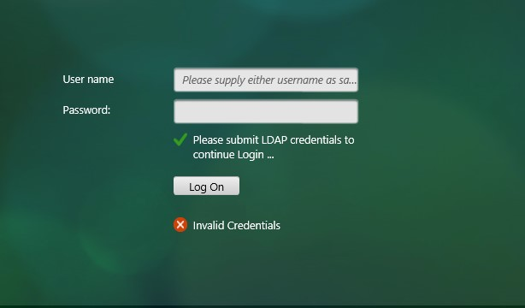
自定义提示信息

Slide 27
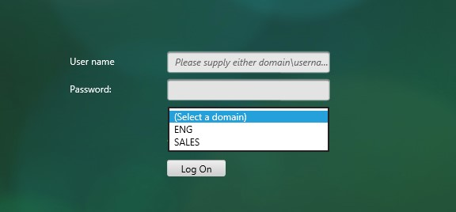
下拉域选项

Slide 28
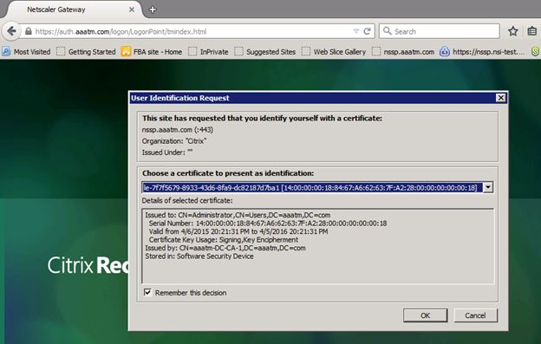
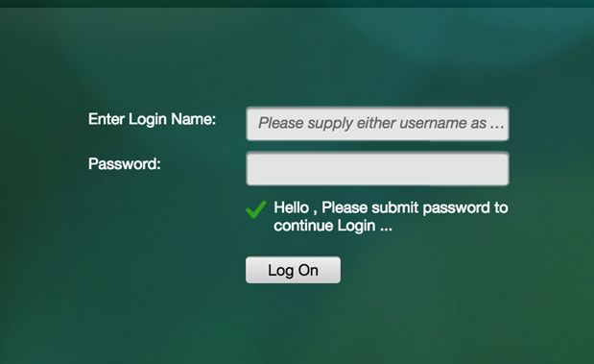
第一种认证失败后转到第二种认证

Slide 29
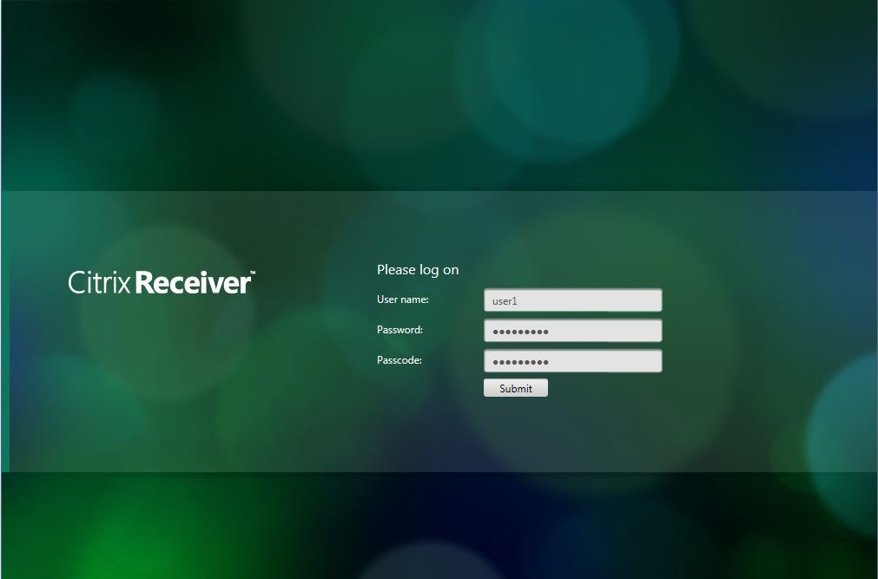
双因素

Slide 30
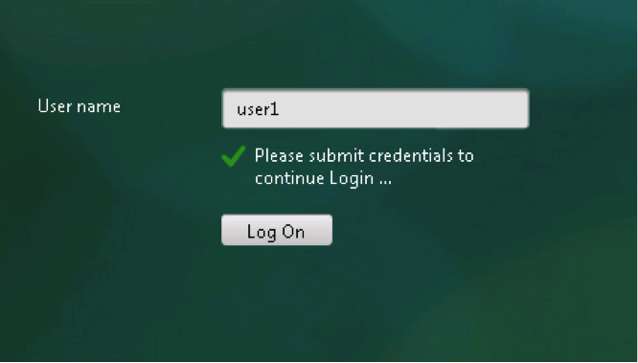
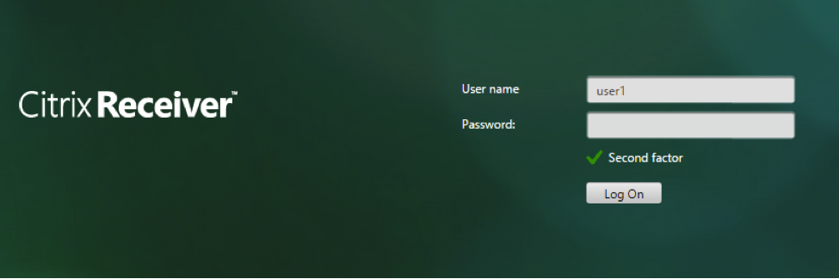
根据用户名选择之后的认证方式

Slide 31
可视化

Slide 32
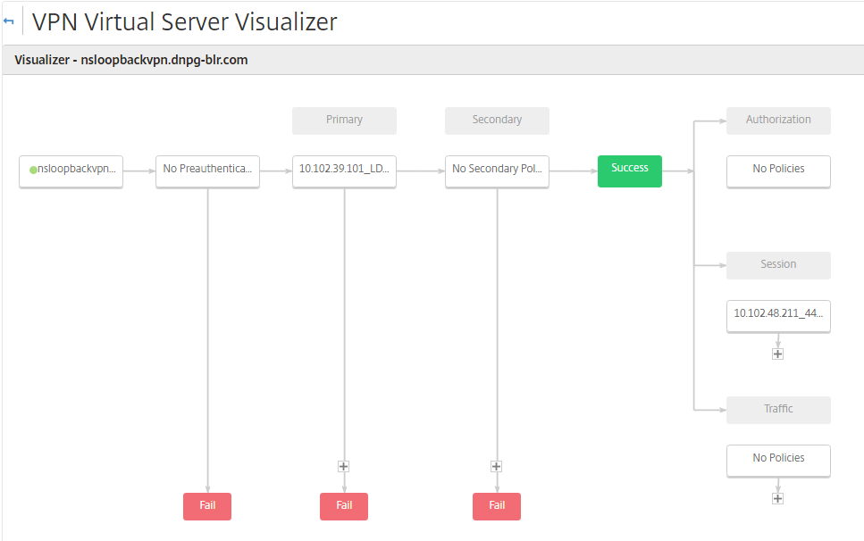
认证流程可视化

Slide 33
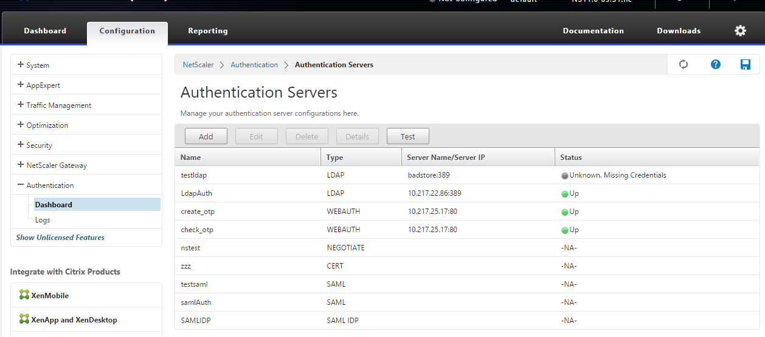
认证服务器可视化

Slide 34
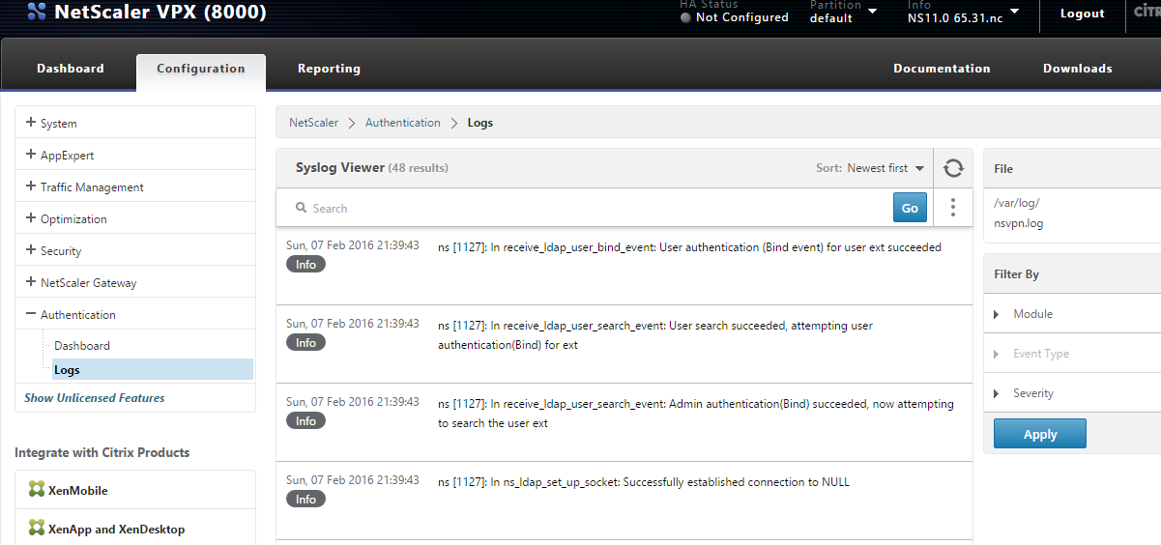
认证日志可视化

Slide 35
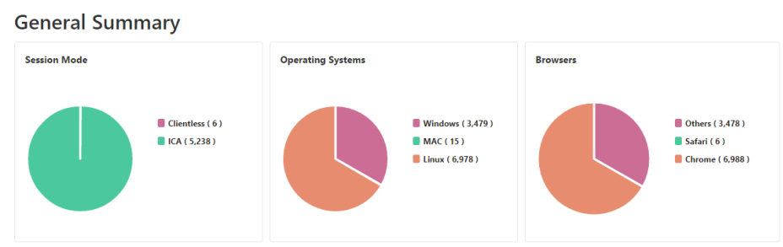
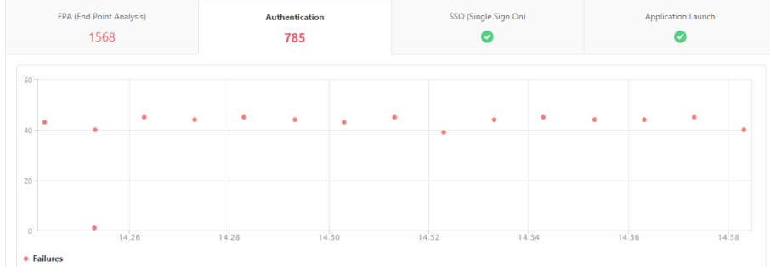
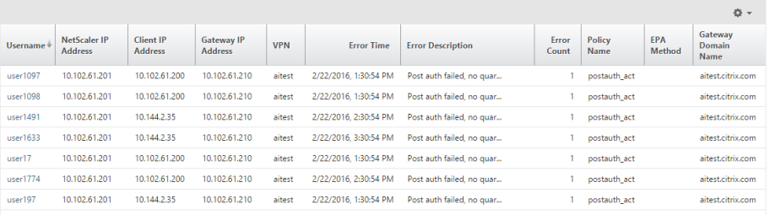
Gateway Insight可视化

Slide 36
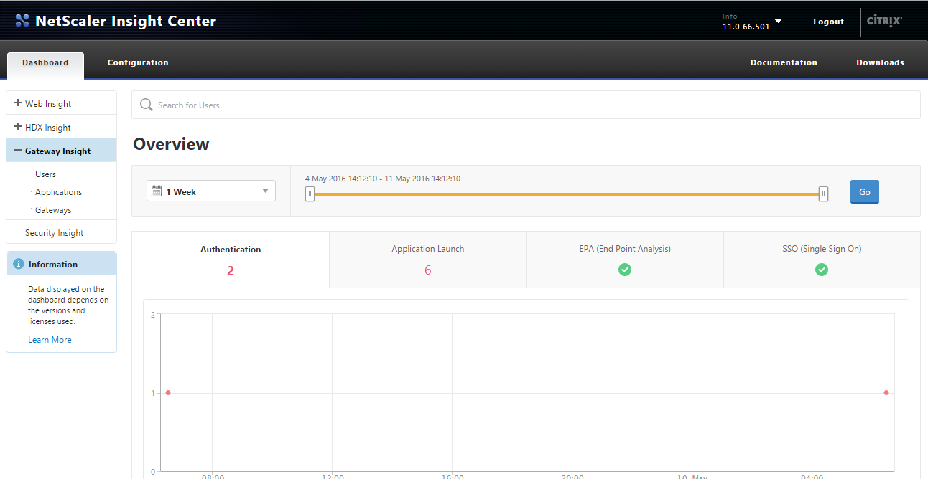
Gateway Insight
Monitor the user’s remote access experience
 | EPA | Auth | SSO | App-launch | Session | Termination
Network access | ✓ | ✓ | ✓ | ✓ | ✓ | ✓
Web access | ✓ | ✓ | ✓ | ✓ | ✓ | ✓
Virtual apps & desktops access | ✓ | ✓ | ✓ | ✓ | ✓ | ✓
Reporting
Access mode

Slide 37
场景

Slide 38
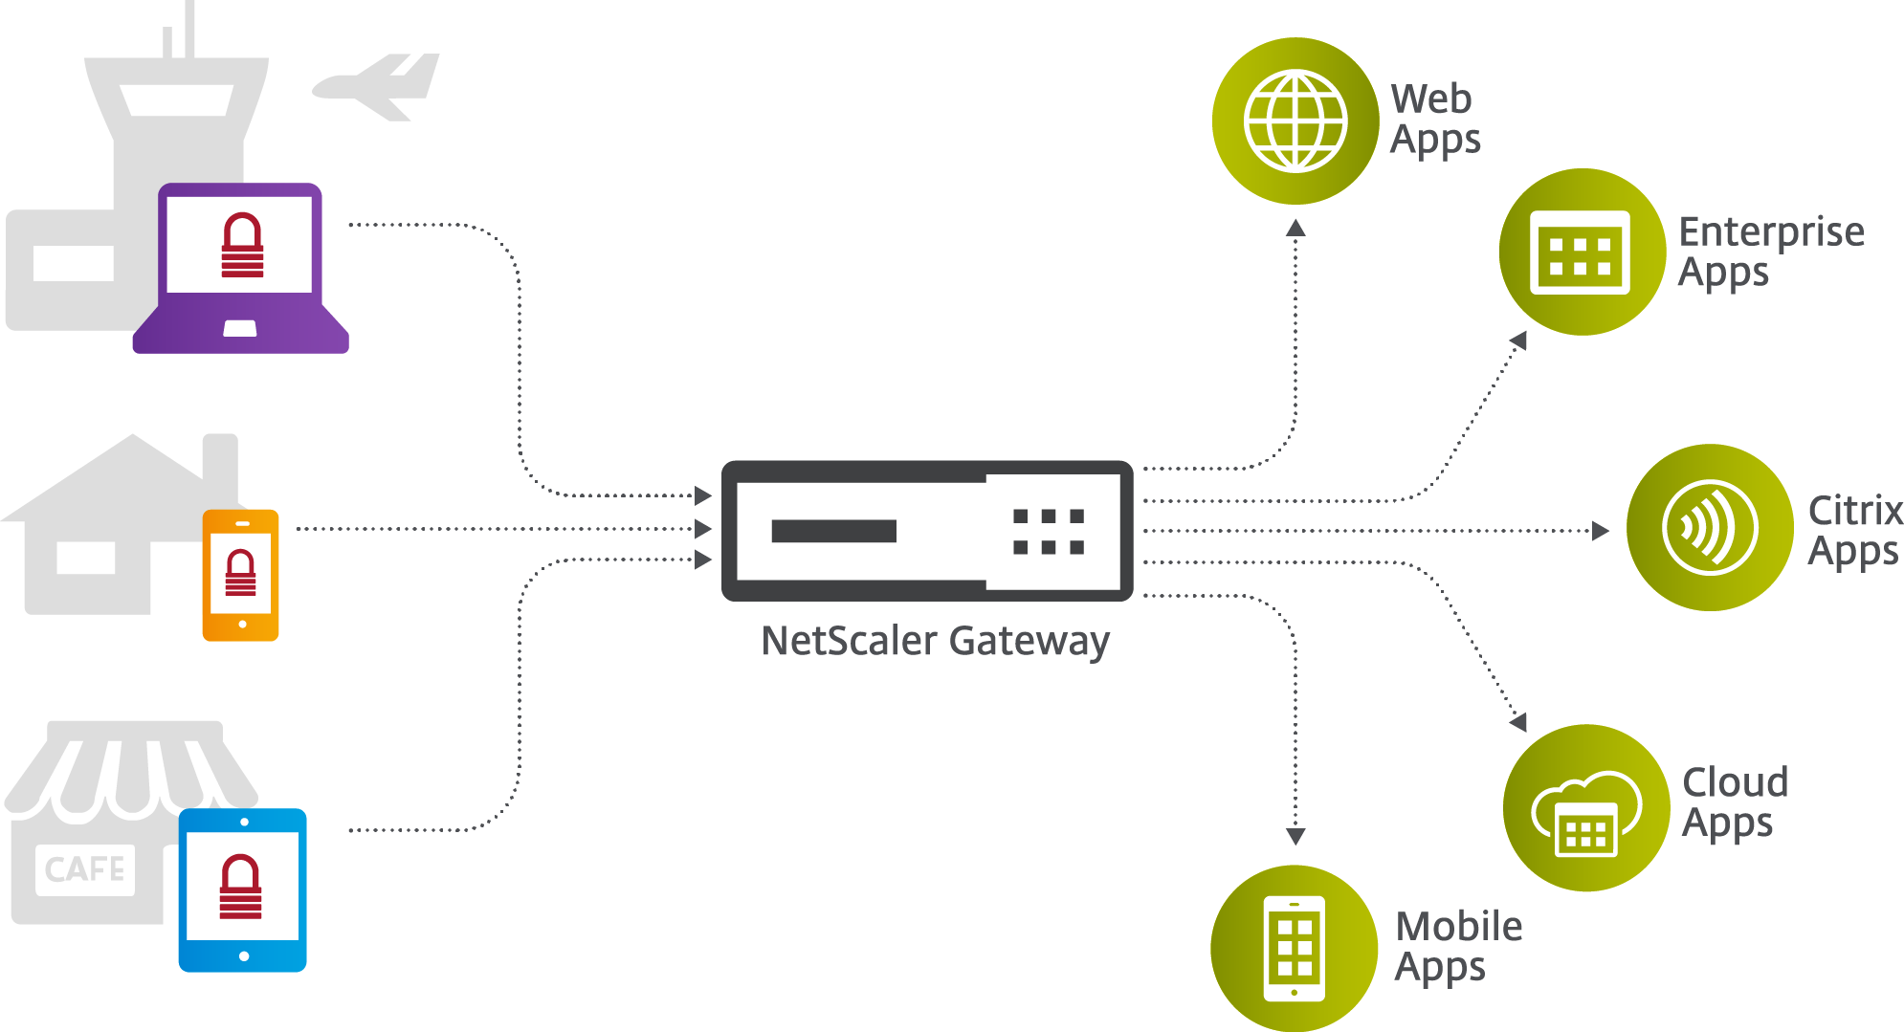
Use Case 1: NetScaler with Unified Gateway为Web和企业传统应用提供安全远程接入
例如:
  ERP/CRM 应用
  SharePoint 应用
  网络文件共享.
为这些应用提供AAA认证监控
用无客户端的VPN 接入Microsoft SharePoint, OWA, Lync
自身或者第三方的单点登录
单一页面整合发布应用

Slide 39
Use Case 2: NetScaler with Unified Gateay 为Citrix XenApp 和 XenDesktop提供安全远程接入
集中策略管理 Citrix XenApp/XenDesktop 应用
EPA 扫描用户设备
优化XA/XD 流量
监控和可视化 XA/XD 流量
自身或者第三方的单点登录
单一页面整合发布应用

Slide 40
Use Case 3: NetScaler with Unified Gateway provides secure and remote access to Cloud and SaaS applications
为cloud 和 SaaS提供 AAA监控
  SalesForce
  Office 365
  sharefile
单点登录所有cloud 和 SaaS 应用
集中化控制策略
单一页面整合发布cloud/SaaS应用

Slide 41
Use Case 4: NetScaler provides seamless integration with XenMobile
Seamless integration with Citrix XenMobile
EPA scans of end user devices
Optimization of XM traffic
Visibility and monitoring tools for XM traffic
Plugin for Android platform
单一页面整合发布应用

